Slide 1
The LabVIEW Environment
07/23/2016

Slide 2
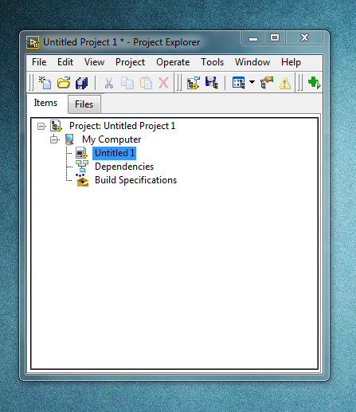
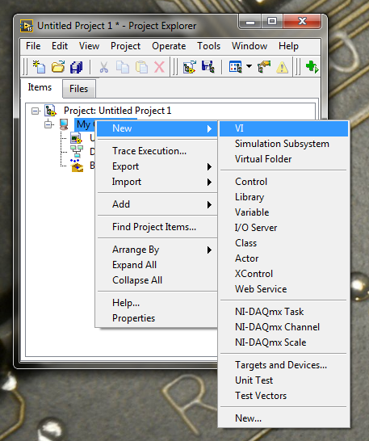
LabVIEW Project
A LabVIEW project is a folder to organize a collection of VIs that work together
Projects are very important for staying organized
You can add VIs to your project by right clicking on “My Computer”

Slide 3
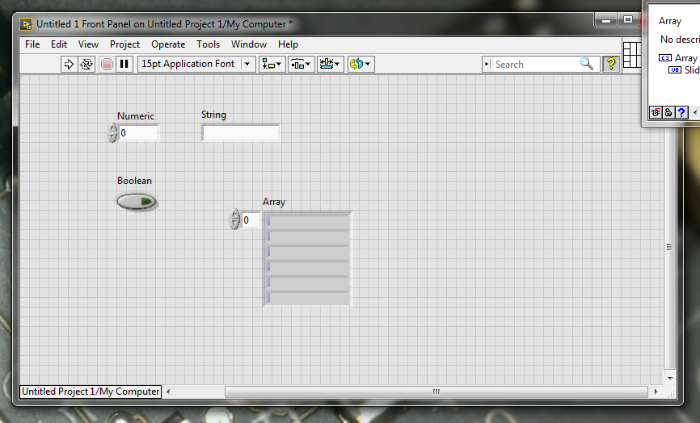
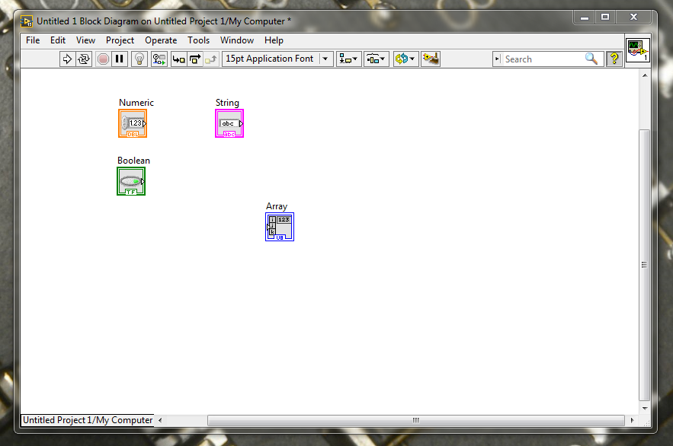
LabVIEW VIs
VI = “Virtual Instrument”
Every VI has a front panel and a block diagram
You can quickly switch between them with the following commands:
CONTROL + E (Show opposite panel)
CONTROL + T (View panels next to each other)

Slide 4
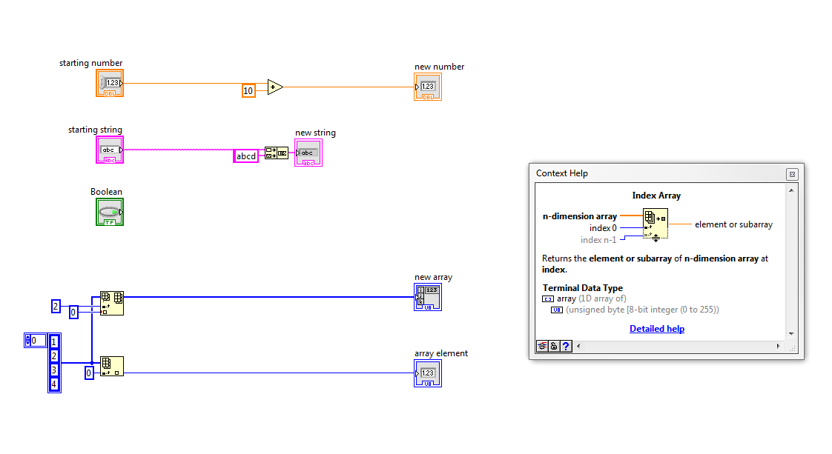
Getting Help in LabVIEW VIs
When you press CONTROL + H on a LabVIEW VI, the help window will appear
When the help window is open, hover over any item and it will tell you more information about it

Slide 5
Getting Help in LabVIEW VIs
When looking at an item on the block diagram, any input listed on a node will be BOLD if it is required to be wired, if the input is not BOLD the input is not optional
Optional inputs usually have a default value that is listed in the description
Forgetting to wire a BOLD input will cause a broken run arrow on your VI

Slide 6
Getting Help in LabVIEW VIs
You can also press “detailed help” in the hovering help window to bring up the page from the LabVIEW manual that covers the element you are interested in

Slide 7
Getting Help in LabVIEW VIs
Open up example_vi_1.vi from the project “Labview Fundamentals.lvproj”
Using the help window, can you predict what the VI will do?

Slide 8
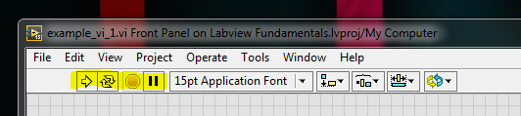
Running LabVIEW VIs
At the top of every LabVIEW VI we have a menu of options for running our code
The “run arrow” will tell the VI to run 1 time
The “run continuously arrow” will tell the VI to run until we stop it, think of this like “auto loop”
The “stop button” will forcefully abort our VI if it is running
The “pause button” will freeze our VI in place, holding it exactly where it was running when we pressed the button

Slide 9
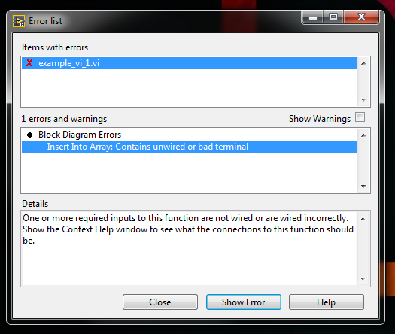
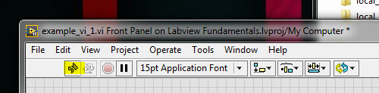
Running LabVIEW VIs
If there is something wrong with our LabVIEW VI we will get a “broken run arrow”
This means that there is a problem on the block diagram that must be fixed
If we click the broken run arrow we can get more info about the problem

Slide 10
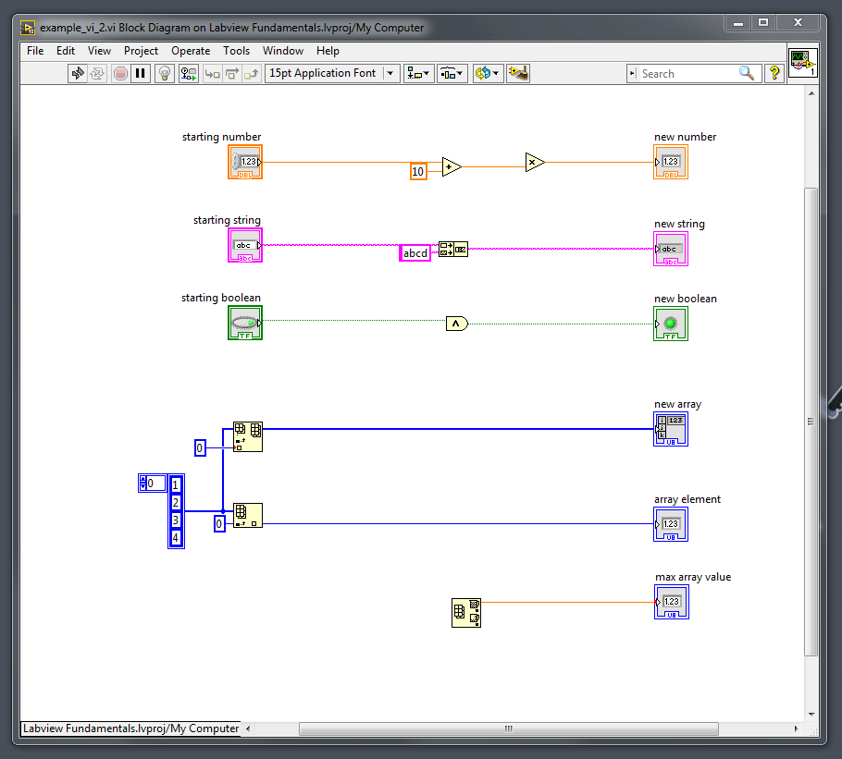
Running LabVIEW VIs
Open “example_vi_2.vi” from LabVIEW fundamentals, see if you can fix all the problems causing the broken run arrow and get the VI to run successfully

Slide 11
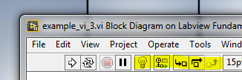
Debugging LabVIEW VIs
When LabVIEW VIs don’t do what we expect them to do, we need to do something called “debugging”
Problems that show up while our programs are running are called “bugs”
LabVIEW has a whole set of tools to help us debug Vis
The debug menu has a light bulb for “highlight execution”, this will trace where the VI is running graphically
The item to the right of the lightbulb is “retain wire values”, this will save the last value of every wire in memory so you can look at them after you run

Slide 12
Debugging LabVIEW VIs
The next three buttons to the left of “retain wire values” are the single stepping buttons
Clicking the single stepping buttons will allow you to manually step through your block diagram one node at a time

Slide 13
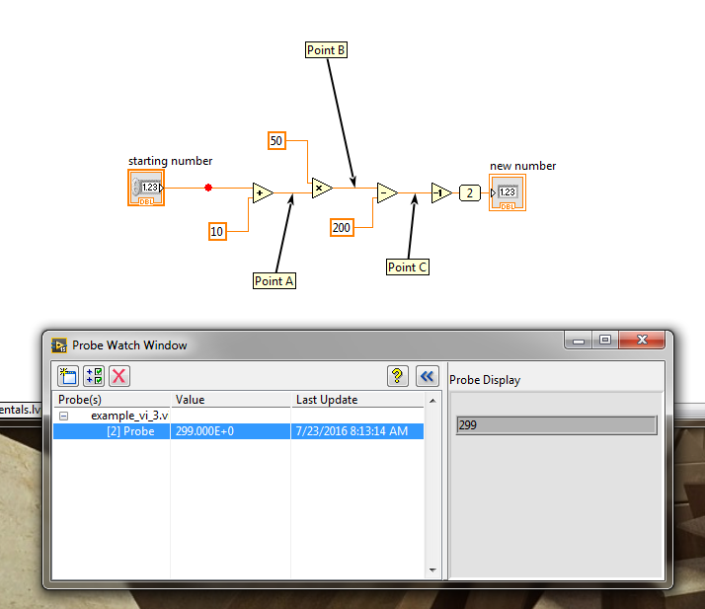
Debugging LabVIEW VIs
The final two debugging tools are called “probes” and “breakpoints”
Probes let you examine the value of a wire on your diagram while it is running
Breakpoints let you stop your VI when it hits a point that you decide
Breakpoints look like small red dots and probes are circular numbers

Slide 14

Debugging LabVIEW VIs
Open “example_vi_3” from the LabVIEW fundamentals project
Try the following exercises:
Run the VI normally, what is the output?
Click the “highlight execution” lightbulb and then run the VI, what do you notice? (Make sure you watch the block diagram)
Leave highlight execution on and click the “single stepping” button (shown below), what do you notice?
Right click the wire named Point A and select “Breakpoint -> Set Breakpoint”, run the VI. What happens?
Right click the wire named Point C and select “Probe”, run the VI. What happens?
Can you find out what the values of Points A, B and C are as the VI runs?

